Slide 1
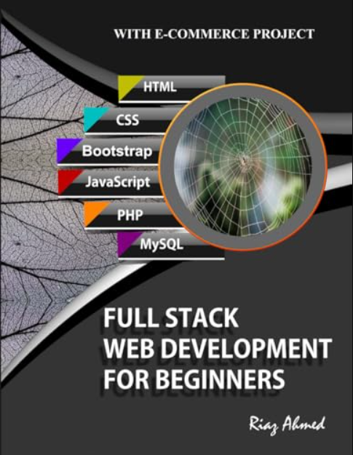
CS230 Tutorial --
Create a Full-Stack App with MongoDB
1- Full-Stack App
2- Configure MongoDB
3- MongoDB Shell
4- Backend - server.js
5- Frontend - HTML + JS
Full Stack Web Development For Beginners:
Riaz Ahmed Amazon Digital Services LLC
– Kdp, 2021 ISBN: 9798738951268

Slide 2
1- Full-Stack App
2- Configure MongoDB
3- MongoDB Shell
4- Backend - server.js
5- Frontend - HTML + JS

Slide 3

Project Architect – Only 3 Files
Backend
One Node.js File
Native HTTP Server
(Without Express)
Dependency: MongoDB
Frontend
HTML + JavaScript
CSS: Only 3 lines
AJAX - XMLHttpRequest
No Frontend Framework

Slide 4
1- Structure of Full Stack APP
Front End
C REATE
R EAD
U PDATE
D ELETE
Response
Request
Back End
Response
Request
Database

Slide 5
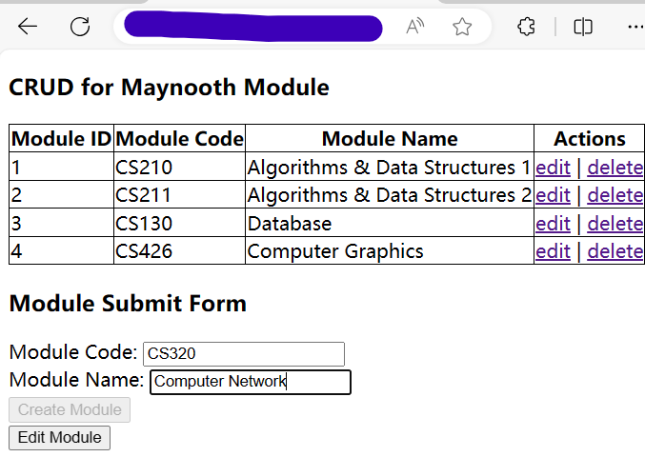

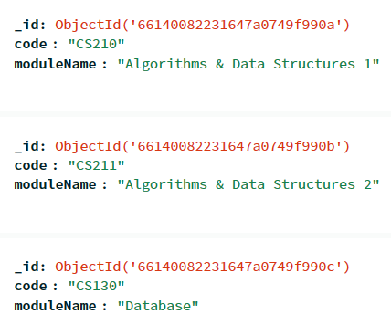
1- How Full Stack APP works?
64
Web Page
④
HTTP
Response
HTTP
Request
①
NodeJS
DB Query
Response
DB Query
Request
③
②
MongoDB

Slide 6
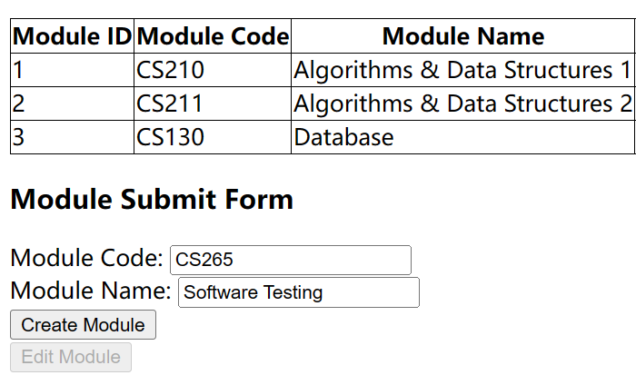

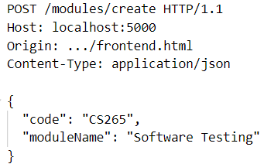
1- [Step 1] HTTP Request
When you Click the Button, the frontend part will send an XMLHttpRequest to the Browser. The browser create a HTTP POST Request and send it to the Server.
Web Browser
Send an XMLHttpRequest
HTTP POST Request
Web Page
Send an HTTP
POST Request
NodeJS

Slide 7
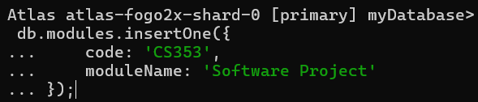

1- [Step 2] SQL Request
After receiving the HTTP POST Request from the Browser, the Server will check the Path and Request Type. If correct, the server will send a Query Request to the Database.
HTTP POST Request
Receive an
HTTP Request
NodeJS
Generate
Query
Database
Send Query to Database

Slide 8

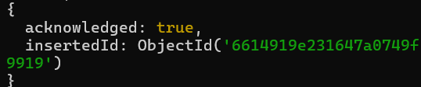
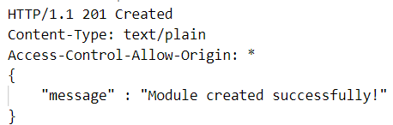
1- [Step 3] SQL Response
If Query Request is entered into the Database successfully, the Query Response will be sent to the Server without error. Then the Server will write HTTP Response Status Code and Body to the Browser.
Get Query Response
Database
Send to Server
No error
HTTP POST Response
Write Response
Head + Body
NodeJS
52

Slide 9
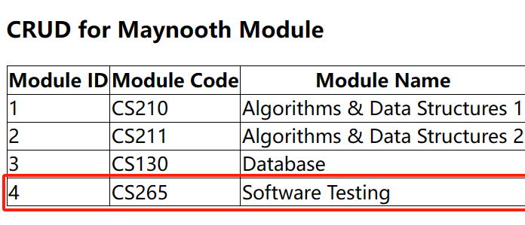
1- [Step 4] HTTP Response
After the Browser receive the HTTP Response, and the Status Code begins with 2(success response). The Frontend will refresh the table and show new Web Page.
HTTP POST Response
Web Browser
Send an HTTP Response
xhr.onload()
Status Code
Begins with 2
New Web Page
Page changes
Refrese Table

Slide 10
1- Full-Stack App
2- Configure MongoDB
3- MongoDB Shell
4- Backend - server.js
5- Frontend - HTML + JS

Slide 11
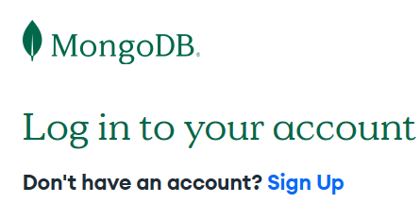
2 – Register MongoDB Account
Register your MongoDB Account at here:
https://account.mongodb.com/account/login/
1) Google 2) GitHub 3) Email

Slide 12
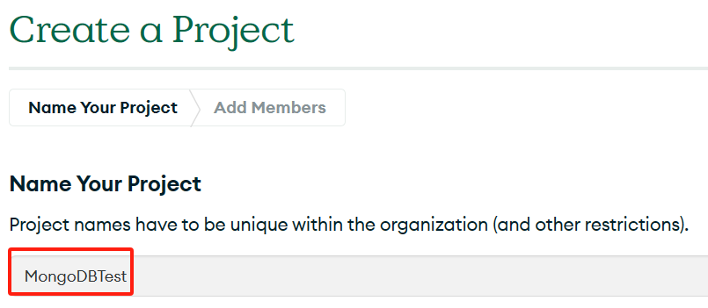
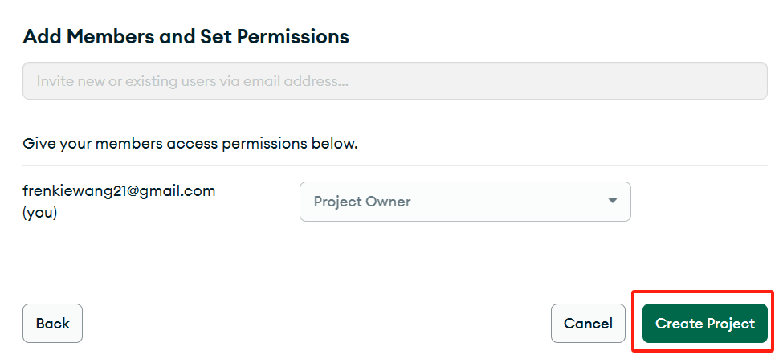
2 – Create a new Project
Step 1
Step 2

Slide 13
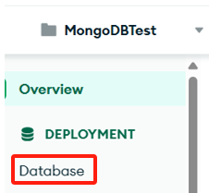
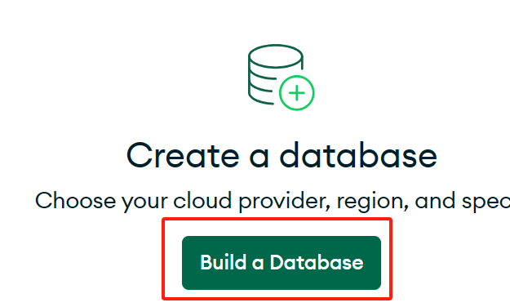
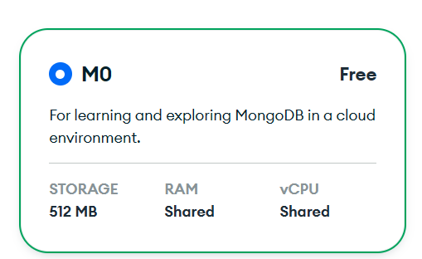
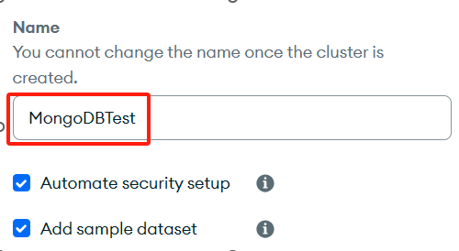
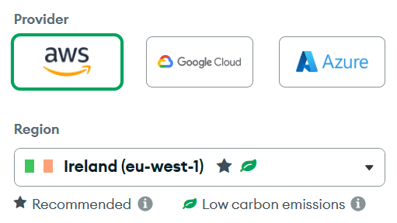
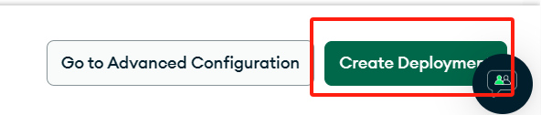
2 – Create a Database

Slide 14
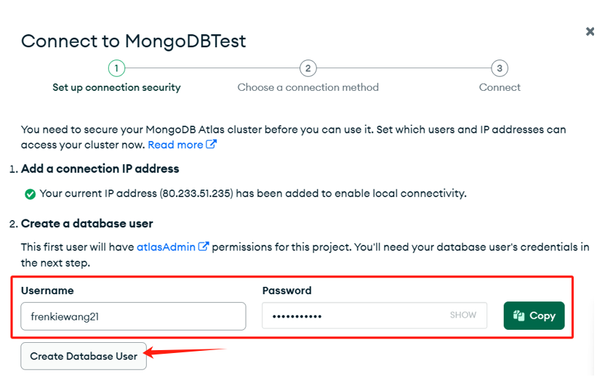

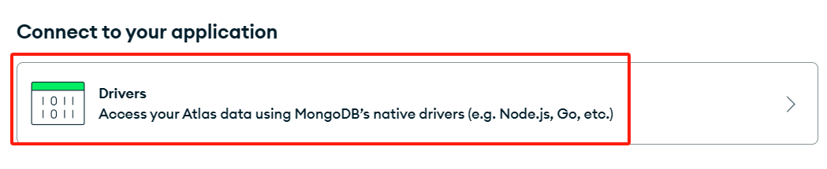
2 – Configure the Database
Step 1
Step 2
Step 3
Step 4

Slide 15
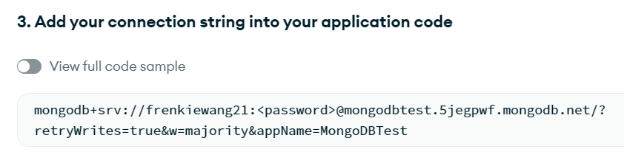
2 – Configure the Database
The password created [Step 1]
22
Add database name before `?`
Step 5: Replace the Password in the Connection String
URI(Uniform Resource Identifier)
Step 6: Copy the URI, paste and save

Slide 16
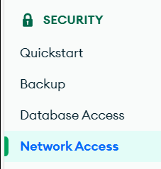

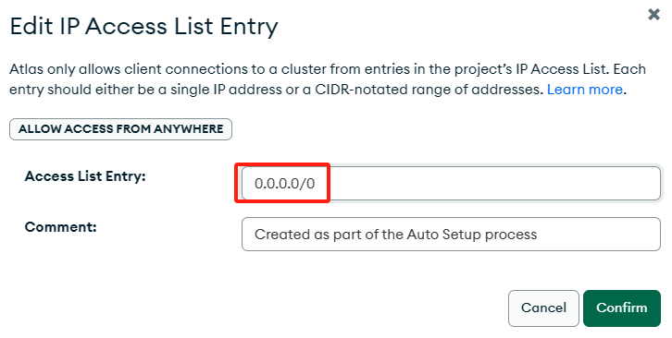
2 – Allow access from anywhere
Step 7: Set IP Address to 0.0.0.0/0

Slide 17
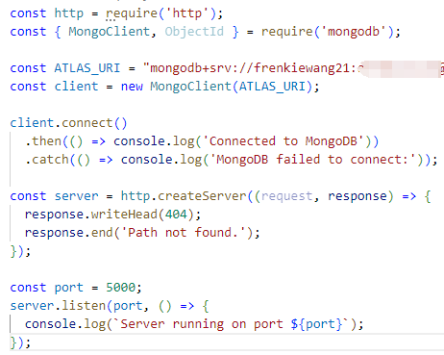
2 – Configure MongoDB in Server
Create a JS file named server.js.
Connect to MongoDB Database.
26
`mongodb` is MongoDB Node.js driver package that provides APIs to interact with MongoDB Database.
You must install the dependency first!
Open Terminal, type:
npm install mongodb

Slide 18


2 – Run MongoDB in Backend Server
Run the server on Terminal:
node server.js
26
If Terminal shows this Console Log
=> Connected to MongoDB.
That means you can use MongoDB Server now.

Slide 19
1- Full-Stack App
2- Configure MongoDB
3- MongoDB Shell
4- Backend - server.js
5- Frontend - HTML + JS

Slide 20

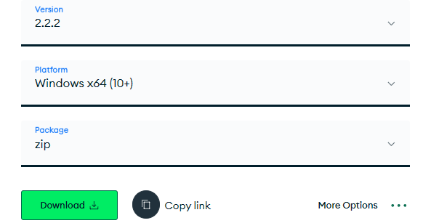

3 – Install MongoDB Shell
Install the MongoDB Shell at here:
https://www.mongodb.com/try/download/shell
An interactive JavaScript interface to MongoDB,
1) Managing databases 2) Querying data - CRUD
Unzip the file

Slide 21
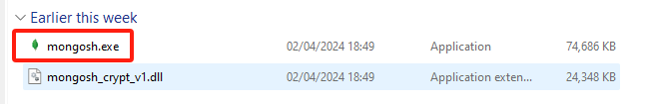
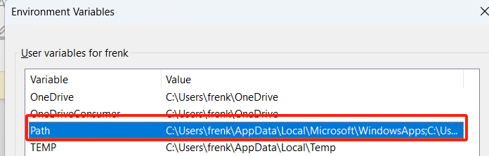
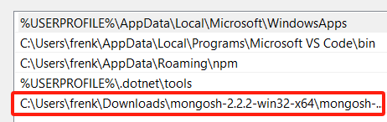
3 – Set Environment Variable
Get the Path of mongosh.exe
Edit Environment Variables - Path
Add the Path of mongosh.exe

Slide 22
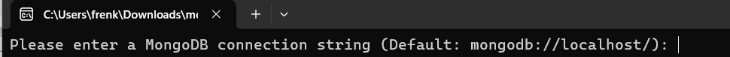
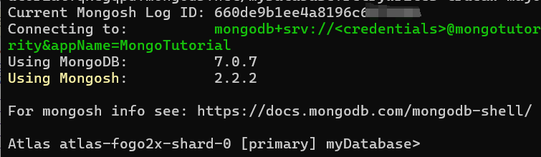
3 – Run MongoDB Shell
Open mongosh.exe
15
Copy and paste the MongoDB URI into mongosh.exe
Connected!

Slide 23

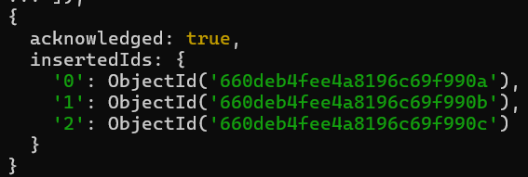
3 – Collection Methods - Initialize
Delete Collection `module` if it exists.
Initialize the Collection – insertMany()

Slide 24


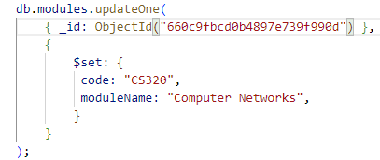

3 – Collection Methods - CRUD
[GET] - Get all Modules
[POST] - Create a Module:
[GET] - Get a Module:
[PUT] - Update a Module:
[DELETE] - Delete a Module:

Slide 25
1- Full-Stack App
2- Configure MongoDB
3- MongoDB Shell
4- Backend - server.js
5- Frontend - HTML + JS

Slide 26
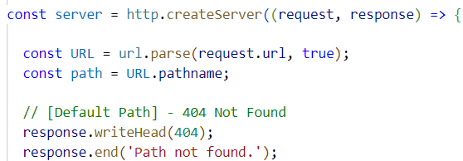
4 – Add 5 Path in Server
17
[GET] - Get all Modules: localhost:5000/modules/get
[POST] - Create a Module: localhost:5000/modules/create
[GET] - Get a Module: localhost:5000/modules/get/:id
[PUT] - Update a Module: localhost:5000/modules/update/:id
[DELETE] - Delete a Module: localhost:5000/modules/delete/:id

Slide 27
4 – Parse URL
17
Get the `URL`.
Parse the Request URL.
[Request URL] http://localhost:5000/modules/get/?code=CS265
url.parse(URLString, true)
URL.hostname = localhost
URL.port = 5000
URL.pathname = modules/get/
URL.query.code = CS265

Slide 28
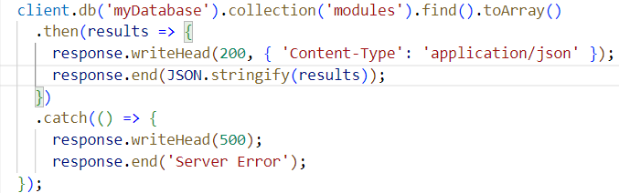
4 – Set DB Query in Server – GET ALL

Slide 29
4 – [Path 1] – GET ALL
[GET ALL] localhost:5000/modules/get

Slide 30

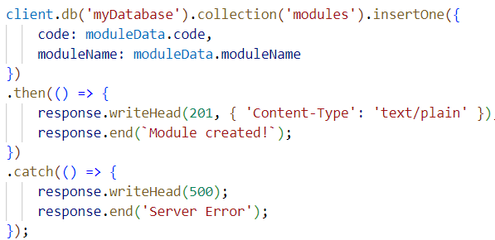
4 – Set DB Query in Server – POST

Slide 31
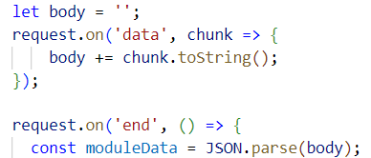
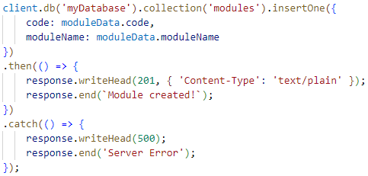
4 – [Path 2] – POST
[POST] - Create a Module: localhost:5000/modules/create

Slide 32
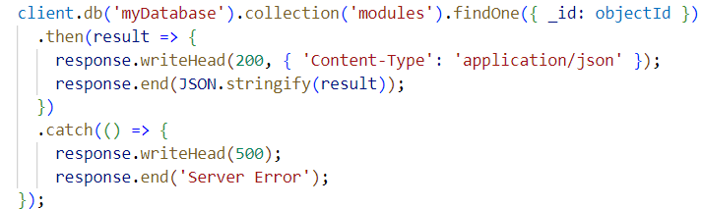
4 – Set DB Query in Server – GET ONE

Slide 33

4 – [Path 3] – GET ONE
[GET ALL] localhost:5000/modules/get/:id

Slide 34
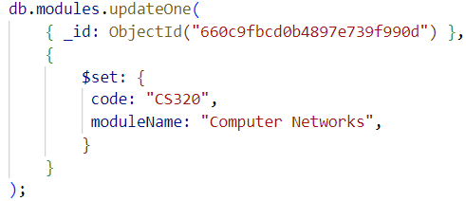
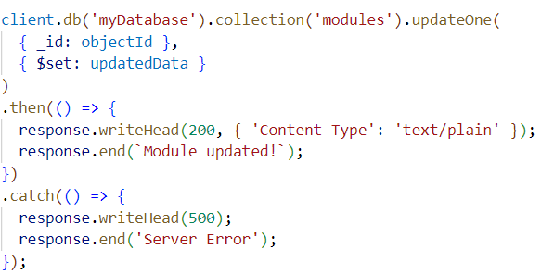
4 – Set DB Query in Server – PUT

Slide 35
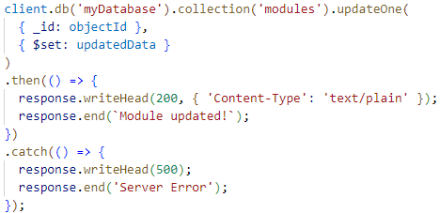
4 – [Path 4] – PUT
[PUT] localhost:5000/modules/update/:id

Slide 36

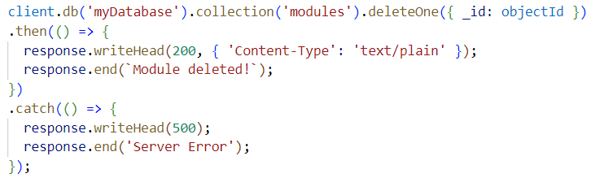
4 – Set DB Query in Server – DELETE

Slide 37
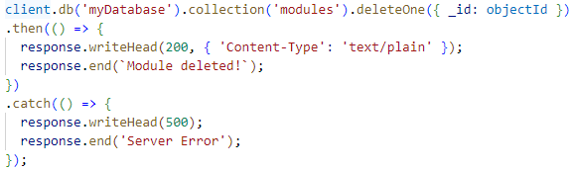
4 – [Path 5] – DELETE
[DELETE] localhost:5000/modules/delete/:id

Slide 38
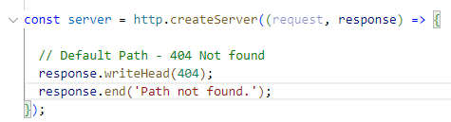

4 – HTTP Request – 6 Paths
Parse URL First
[GET] - Get all Modules: localhost:5000/modules/get
[POST] - Create a Module: localhost:5000/modules/create
[GET] - Get a Module: localhost:5000/modules/get/:id
[PUT] - Update a Module: localhost:5000/modules/update/:id
[DELETE] - Delete a Module: localhost:5000/modules/delete/:id
[Default] – Not Found: other URL

Slide 39
4 – [Backend] Server Structure
Import Packages
Connect MongoDB
Configure Server
CORS Header
Parse URL Path
Path for CRUD
Default Path
Listen to PORT

Slide 40
4 - How Full Stack APP works?
Web Page
④
HTTP
Response
HTTP
Request
①
NodeJS
SQL
Response
SQL
Request
③
②
MongoDB

Slide 41
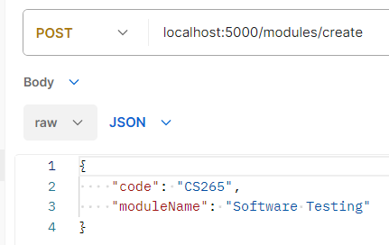
4- Postman – Simulate HTTP Request
Postman
④
HTTP
Response
HTTP
Request
①
NodeJS
SQL
Response
SQL
Request
③
②
MongoDB

Slide 42

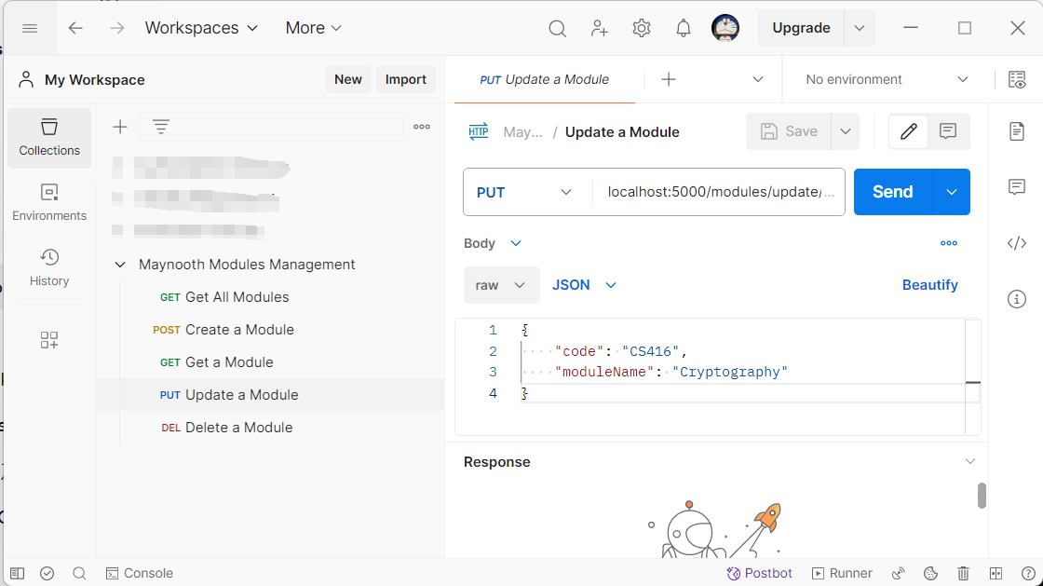

4- Postman - Simulate HTTP Request
Register and download Postman at here:
https://www.postman.com/downloads/
Simulate the HTTP Request from the Web Page.

Slide 43


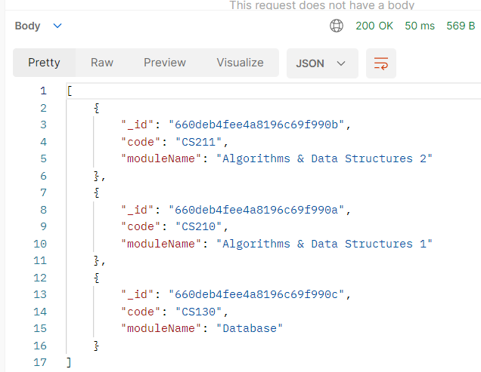
4 – [Path 1] – GET ALL
[GET ALL] localhost:5000/modules/get
Request Line
Request Body
Response

Slide 44

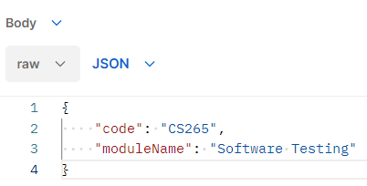
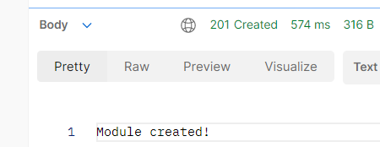
4 – [Path 2] – POST
[POST] - Create a Module: localhost:5000/modules/create
Request Line
Request Body
Response

Slide 45
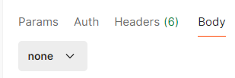

4 – [Path 3] – GET ONE
[GET ALL] localhost:5000/modules/get/:id
Request Line
Request Body
Response

Slide 46


4 – [Path 4] – PUT
[PUT] localhost:5000/modules/update/:id
Request Line
Request Body
Response

Slide 47


4 – [Path 5] – DELETE
[DELETE] localhost:5000/modules/delete/:id
Request Line
Request Body
Response

Slide 48
1- Full-Stack App
2- Configure MongoDB
3- MongoDB Shell
4- Backend - server.js
5- Frontend - HTML + JS

Slide 49
4- Postman – Simulate HTTP Request
Postman
④
HTTP
Response
HTTP
Request
①
NodeJS
SQL
Response
SQL
Request
③
②
MongoDB

Slide 50
5 - XMLHttpRequest
Web Page
JavaScript uses XMLHttpRequest to control the Web browser to send an HTTP Request.
④
HTTP
Response
XMLHttpRequest
①
NodeJS
SQL
Response
SQL
Request
③
②
MongoDB

Slide 51

5 - XMLHttpRequest
Status Code begins with 2
(200, 201…)

Slide 52
5 – Common Status Code
200 (Success) – The server request was successful
201 (Created) – The server request was successful and new content was created.
400 (Wrong request) - The server did not understand the Syntax.
401 (Unauthorized) - The request requires authentication (username + password).
403 (Forbidden) - No permission to access.
404 (Not found) - The requested content does not exist.
408 (Request Timeout) – The waiting time is too long
500 (Internal Server Error) – There is an error within the server.
08

Slide 53
5 – Status Code – 3 Digits
Begin with 1 - Received
– The request was received.
Begin with 2 - Succeed
– The request was successfully accepted.
Begin with 3 – Redirection
–The resource was moved to another location
Begin with 4 - Client Error
– The request has errors, so the server cannot process it.
. Begin with 5 - Server Error
– The server itself has errors.

Slide 54


5 – Initialize Frontend
connect CSS
Structure of HTML file
When the Web Page loads successfully, run these codes.

Slide 55
5 – Table Element
th | th | th | th | th
td | td | td | td | td
td | td | td | td | td
td | td | td | td | td
td | td | td | td | td
tr
thead
tr
tr
table
tbody
tr
tr

Slide 56


5 – Table Element

Slide 57


5 – Make a Table to Store Data
HTML file
Fetch all Modules in XMLHttpRequest
Web Page

Slide 58

5 – [GET] XMLHttpRequest
69

Slide 59

5 – [GET] XMLHttpRequest
[JSON] responseText
currentModule

Slide 60


5 – Wrap them in a function
Send an HTTP Get Request when Web Page is loaded

Slide 61

5 – CORS Policy
Why I get this Error?
You forget to set CORS Policy
in the Response Header !!!
CORS (Cross-Origin Resource Sharing)
For security reasons, when the URL of the Web Page and the Server are different, by default, the Server will reject the HTTP request of the Web Page.
In order to avoid this CORS error, we need to set a CORS Policy in the Response Header, so that we can relax these restrictions and allow Cross-Origin Resource Sharing.

Slide 62

5 – CORS Policy
Set Origin, Methods and Headers of CORS Policy in Response.
[OPTIONS] -> Preflight request
Prefligh request is part of the Cross-Origin Resource Sharing (CORS) Protocol. Before the Browser makes an HTTP request, the Browser will send a preflight request first, in order to confirm that the Server is Safe.

Slide 63
5 – What is Preflight?
Before the Browser makes a POST Request, the Browser will send a Preflight Request to the Server first. After the Server accepts the Cross-Origin Request, it will send a Preflight Response. Only if the Preflight Response is OK, the Browser can make a POST Request and get its Response.
05
③
POST Request
Preflight Request
①
Web Page
NodeJS
②
Preflight Response
④
POST Response

Slide 64


5 – Preflight Request and Response
[POST] - Create a Module: localhost:5000/modules/create
① Preflight Request
② Preflight Response

Slide 65


5 – Real POST Request and Response
[POST] - Create a Module: localhost:5000/modules/create
③ Real Post Request
④ Real Post Response

Slide 66


5 - Make Submit Form in HTML
HTML file
Web Page

Slide 67


5 - Get From Data in HTML
“FormData” is a JavaScript Class, input the “id” of a Form, then it store the content of form.
https://developer.mozilla.org/en-US/docs/Web/API/FormData/FormData

Slide 68

5 – [Create] XMLHttpRequest
69
73
1- Fetch all data in From
Refresh the Table when the Create request is accepted successfully.
2- XMLHttpRequest – Create a Module

Slide 69

5 – JSON <--> String
Fast in Request
Transmission.
String
JSON.stringify()
JSON.parse()
58
68
JSON
Array of Objects
Easy to manipulate.

Slide 70




5 – Add Event Listener - Click

Slide 71

5 – Wrap them in EventListener
Event Listener of Button Click
69

Slide 72


5 – [Frontend] HTML File

Slide 73

5 – [Frontend] JavaScript File

Slide 74
What we learned this Class?
1 – How to register MongoDB?
2 – How to connect with MongoDB?
3 – Create a Server to Realize CRUD.
4 – Use Postman to test Server Path.
5 – Use Web Page to Read and Create.

Slide 75
The Plan for Next Class
1 – Realize Update and Delete function in the Web Page.
2 – Use Express Framework instead of HTTP Header at Backend.
3 – Use Axios Framework instead of XMLHttpRequest at Frontend.

Slide 76


My Contact Information
Microsoft Teams
wang.zhoukan.2022@mumail.ie
Email
Connect me on LinkedIn
https://www.linkedin.com/in/frenkie-wang-71ba0a1b5/
Don’t ask me any questions about your CS230 Assignments, I am not allowed to help you!!!

